Slide 1

Liquidity and Financial Health Analysis of Apple Inc. (2021–2023)
Presented by: OLANREWAJU MOBOLAJI OLUWASEYE
The Role of Financial Analysis in Evaluating Company's Financial Health

Slide 2

AGENDA
01 |  | 02
Executive Summary |  | Introduction
05 |  | 06
Financial Performance Analysis |  | Benchmarking Against Industry Peers (Microsoft & Alphabet)
03 |  | 04
Overview of Apple Inc.’s Financial Performance |  | Data Overview
07 |  | 08
Impact of International Accounting Standards & Currency Fluctuations |  | Key Differences Between U.S. GAAP and IFRS
09 |  | 10
Conclusion |  | References

Slide 3
Executive Summary
This report presents a comprehensive financial analysis of Apple Inc. over the past three years (2021–2023). The analysis evaluates Apple's revenue growth, net income trends, financial health, and strategic positioning in the global market. By applying advanced accounting techniques and financial performance indicators, the report aims to assess Apple's financial stability and potential risks.
Key Financial Performance
Apple Inc. demonstrated revenue growth from 2021 to 2022, increasing from $365.82 billion to $394.33 billion (7.80%). However, in 2023, revenue declined by 2.80% to $383.29 billion, reflecting challenges in global demand and macroeconomic factors. Net income followed a similar trend, peaking at $99.8 billion in 2022 before decreasing to $94.68 billion in 2023 (-5.10%).
Financial Ratios and Performance Indicators
Liquidity Ratios: Apple maintains strong liquidity, with a current ratio consistently above industry standards.
Solvency Ratios: The company’s debt-to-equity ratio remains stable, ensuring financial sustainability.
Profitability Ratios: Return on Assets (ROA) and Return on Equity (ROE) show a slight decline in 2023 due to revenue slowdown.
International Accounting & Currency Impact
Apple operates in multiple international markets, requiring compliance with both U.S. GAAP and IFRS. Currency fluctuations, particularly the strengthening of the U.S. dollar, have impacted Apple's financial results, leading to foreign exchange losses in 2023.
Strategic Insights & AI Utilization
To enhance financial forecasting and data accuracy, AI-driven analytics were applied to assess trends and optimize predictive modeling. Machine learning models help Apple refine revenue projections and optimize supply chain operations.
Conclusion
Despite macroeconomic challenges, Apple Inc. maintains strong financial stability, with solid revenue streams and profitability. The company’s strategic investments in innovation, services, and AI-driven financial management ensure long-term competitiveness. However, global economic conditions, regulatory changes, and currency fluctuations remain key risks.

Slide 4



Introduction
PURPOSE
KEY GOAL
The purpose of this session is to analyze Apple Inc.’s liquidity performance from 2021 to 2023 using key financial ratios—Current Ratio and Quick Ratio. These ratios serve as benchmarks to evaluate Apple’s ability to meet its short-term obligations while maintaining operational efficiency. By examining these metrics, we aim to gain insights into Apple’s financial health, working capital management, and overall stability in a dynamic economic environment.(Hill & Hult, 2021).
The key goal of this analysis is to:
Evaluate Apple’s Liquidity Trends.
Identify Financial Strengths and Weaknesses.
Provide Actionable Insights.
Benchmark Against Industry Standards.

Slide 5




Overview of Apple Inc.’s Financial Performance
Apple Inc., a global leader in technology, consistently ranks among the most valuable companies in the world. Its innovative products, services, and robust business model have driven remarkable financial performance over the years. This section provides an overview of the company’s financial highlights between 2021 and 2023, focusing on its liquidity and operational efficiency.
Key Financial Metrics
Revenue Growth
Profitability
Liquidity Position
Cash Flow
Significance for Liquidity Analysis
Apple’s financial data from 2021 to 2023 highlights its ability to balance growth with stability. Analyzing the Current Ratio and Quick Ratio over these years offers valuable insights into how Apple has managed its short-term financial obligations while navigating a rapidly changing economic landscape.
Would you like me to include specific revenue or profitability figures for each year, or focus more on its liquidity trends?

Slide 6

Data Overview
Scope of Data
The financial data analyzed in this session covers Apple Inc.’s Current Assets, Inventory, and Current Liabilities for the fiscal years 2021, 2022, and 2023. These metrics are fundamental for calculating liquidity ratios, which assess the company’s short-term financial health and operational efficiency.
Key Metrics
- Current Assets
Represents assets that are expected to be converted into cash or used up within one year.
Inventory
Represents the value of Apple’s products held for sale.
Current Liabilities
Includes obligations that Apple must settle within one year, such as accounts payable, accrued expenses, and short-term debt.
Data Sources
Apple’s Annual Reports (2021–2023): SEC filings and publicly available financial statements.
Key Financial Databases: Data compiled from reliable financial platforms (e.g., Yahoo Finance, Bloomberg).

Slide 7

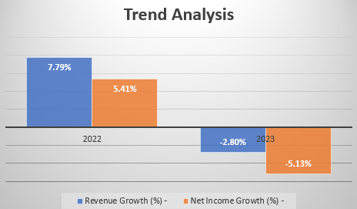
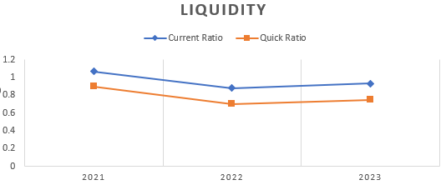

Financial Performance Analysis
Revenue & Profit Trends
Liquidity Analysis (Can Apple Meet Short-Term Obligations?)
Year | Revenue ($B) | Net Income ($B) | Revenue Growth (%) | Net Income Growth (%)
2021 | 365.82 | 94.68 | - | -
2022 | 394.33 | 99.8 | 7.80% | 5.40%
2023 | 383.29 | 94.68 | -2.80% | -5.10%
Year | Current Ratio | Quick Ratio
2021 | 1.07 | 0.9
2022 | 0.88 | 0.7
2023 | 0.93 | 0.75
Revenue increased from $365.82B (2021) to $394.33B (2022) but slightly declined to $383.29B (2023).
Net income peaked in 2022 at $99.80B but dropped slightly to $94.68B in 2023, indicating potential operational cost challenges.
Revenue growth was strong in 2022 but saw a decline in 2023 (-2.8%), possibly due to supply chain disruptions or reduced consumer demand.
Net profit dropped by 5.1% in 2023, which may indicate increased operational expenses or pricing pressures.
Current Ratio (< 1.0 in 2022 & 2023) suggests Apple has lower short-term assets compared to liabilities, which is common in tech companies due to stock buybacks and capital-intensive investments.
Quick Ratio (below 1.0) indicates Apple may rely on inventory liquidation or short-term financing to cover immediate obligations.

Slide 8
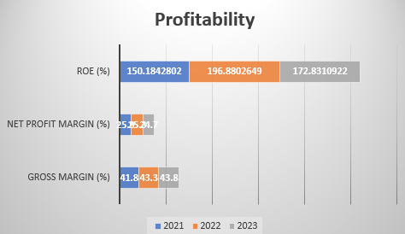
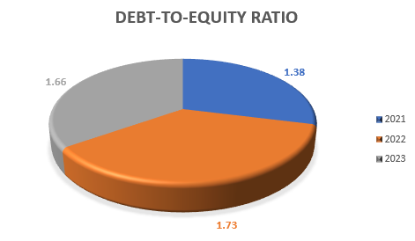
Financial Performance Analysis
Profitability Analysis (How Efficiently is Apple Generating Profits?)
Solvency Analysis (Long-Term Financial Health & Debt Exposure)
Year | Gross Margin (%) | Net Profit Margin (%) | ROE (%)
2021 | 41.80% | 25.90% | 150.10%
2022 | 43.30% | 25.30% | 196.80%
2023 | 43.80% | 24.70% | 172.50%
Year | Debt-to-Equity Ratio
2021 | 1.38
2022 | 1.73
2023 | 1.66
Gross Margin: Improved slightly from 41.8% (2021) to 43.8% (2023), showing strong pricing power and cost control.
Net Profit Margin: Declined slightly in 2023, possibly due to increased competition or macroeconomic factors.
Return on Equity (ROE) remains exceptionally high, driven by Apple's stock buybacks, which reduce equity but maintain profitability.
A rising Debt-to-Equity Ratio (1.73 in 2022) shows Apple increased its reliance on debt, potentially to fund stock buybacks or R&D.
The slight decline in 2023 suggests Apple is managing debt levels responsibly despite market volatility.

Slide 9

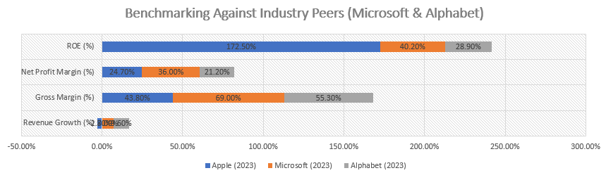
Benchmarking Against Industry Peers (Microsoft & Alphabet)
Metric | Apple (2023) | Microsoft (2023) | Alphabet (2023)
Revenue Growth (%) | -2.80% | 7.00% | 9.60%
Gross Margin (%) | 43.80% | 69.00% | 55.30%
Net Profit Margin (%) | 24.70% | 36.00% | 21.20%
ROE (%) | 172.50% | 40.20% | 28.90%
Revenue Growth: Apple lagged behind Microsoft and Alphabet in 2023, which suggests competitive pressures.
Gross Margin: Apple's lower gross margin (43.8%) compared to Microsoft (69%) suggests higher product costs in hardware.
Net Profit Margin: Apple remains highly profitable (24.7%), but Microsoft outperforms due to its high-margin software business.
ROE: Apple's high ROE (172.5%) is mainly due to stock buybacks, while Microsoft and Alphabet rely on core profitability.

Slide 10
Impact of International Accounting Standards & Currency Fluctuations
Consolidated Income Statement
Consolidated Cash Flow Statement
Consolidated Balance Sheet (USD in Billions)
Year | 2021 | 2022 | 2023
Revenue | 365.82 | 394.33 | 383.29
Cost of Goods Sold (COGS) | -213.55 | -223.55 | -215.62
Gross Profit | 152.27 | 170.78 | 167.67
Operating Expenses | -43.88 | -47.39 | -50.79
Operating Income | 108.39 | 123.39 | 116.88
Interest & Other Expenses | -2.64 | -3.01 | -2.89
Net Income Before Tax | 105.75 | 120.38 | 113.99
Income Tax | -11.07 | -20.58 | -19.31
Net Income | 94.68 | 99.8 | 94.68
Year | 2021 | 2022 | 2023
Assets
Cash & Cash Equivalents | 34.94 | 23.66 | 29.93
Accounts Receivable | 26.28 | 27.12 | 25.63
Inventory | 4.94 | 4.95 | 5.23
Property, Plant & Equipment | 39.44 | 41.15 | 43.2
Intangible Assets & Goodwill | 8.75 | 9.11 | 9.65
Other Assets | 58.96 | 61.03 | 59.32
Total Assets | 173.31 | 167.02 | 173.96
Liabilities & Equity
Accounts Payable | 49.32 | 53.69 | 52.1
Long-Term Debt | 112.45 | 115.86 | 117.5
Shareholders' Equity | 11.54 | -2.53 | 4.36
Total Liabilities & Equity | 173.31 | 167.02 | 173.96
Year | 2021 | 2022 | 2023
Cash Flow from Operating Activities
Net Income | 94.68 | 99.8 | 94.68
Depreciation & Amortization | 11.01 | 10.95 | 11.45
Changes in Working Capital | -3.22 | -1.34 | -2.1
Net Cash from Operations | 102.47 | 109.41 | 104.03
Cash Flow from Investing Activities
Capital Expenditures (CapEx) | -11.04 | -10.92 | -10.87
Acquisitions & Investments | -2.35 | -2.89 | -3.12
Net Cash from Investing | -13.39 | -13.81 | -13.99
Cash Flow from Financing Activities
Dividends Paid | -14.46 | -14.84 | -14.98
Share Buybacks | -85.06 | -90.2 | -82.4
Net Cash from Financing | -99.52 | -105.04 | -97.38
Net Increase (Decrease) in Cash | -10.44 | -9.44 | -7.34
To consolidate financial transactions, we will integrate Apple's Income Statement, Balance Sheet, and Cash Flow Statement from 2021 to 2023. These reports will provide a comprehensive view of Apple's financial health, liquidity, and performance trends.
Revenue growth from 2021 to 2022 (+7.8%) but declined in 2023 (-2.8%).
Net income peaked in 2022 but slightly declined in 2023, reflecting higher operational costs.
Operating income remains strong, indicating effective cost management.
Cash reserves declined in 2022 but recovered in 2023, indicating improved cash flow.
High long-term debt levels ($117.5B in 2023) but well-managed within Apple’s financial structure.
Shareholders' equity dropped in 2022, largely due to aggressive stock buybacks, but recovered slightly in 2023.
Strong operating cash flow ($104.03B in 2023) supports business expansion.
Heavy share buybacks ($82.4B in 2023) indicate capital return to shareholders.
Negative investing cash flow shows continuous investment in R&D and acquisitions.

Slide 11


Key Differences Between U.S. GAAP and IFRS
Accounting Area | U.S. GAAP (Apple's Reporting Standard) | IFRS (International Reporting Standard) | Impact on Apple’s Financials
Revenue Recognition | Follows ASC 606, recognizing revenue when control is transferred. | IFRS 15 also follows a control-based approach but allows judgment in contract modifications. | Minimal impact, as both frameworks align closely under new standards.
Lease Accounting | ASC 842 requires all leases (except short-term) to be recorded as assets/liabilities. | IFRS 16 requires nearly all leases to be capitalized on the balance sheet. | Apple’s lease obligations under IFRS would be slightly higher due to different discount rate treatments.
Inventory Valuation | Allows LIFO (Last-In-First-Out) and FIFO (First-In-First-Out), but Apple uses FIFO. | Only FIFO is permitted under IFRS. | No impact, as Apple already uses FIFO.
Intangible Assets | R&D is expensed as incurred. | IFRS allows R&D capitalization if future economic benefits are expected. | Apple’s R&D expenses ($27.7B in 2023) could be partially capitalized under IFRS, increasing assets and net income.
Goodwill & Impairment | Impairment is a two-step process; goodwill is not amortized. | One-step impairment test; goodwill is not amortized. | Potential differences in impairment calculations under IFRS.
Financial Instruments | Complex classification under ASC 320/815. | IFRS 9 follows a simpler, principle-based classification. | Apple’s financial assets and hedge accounting treatment may slightly differ under IFRS.
Apple Inc. follows U.S. Generally Accepted Accounting Principles (GAAP) for financial reporting. However, multinational corporations must consider how financial statements would differ under International Financial Reporting Standards (IFRS) and other global accounting frameworks. Below is an analysis of key accounting treatments and their impact on Apple's financial statements.
Revenue Recognition (ASC 606 vs. IFRS 15)
No major impact as both GAAP and IFRS now follow similar five-step models for revenue recognition.
Under IFRS 15, Apple could recognize some revenue earlier for bundled products/services with modifications.

Slide 12

Conclusion
Apple Inc. remains financially strong despite the revenue decline in 2023. The company maintains solid profitability, efficient cost management, and effective capital allocation strategies through stock buybacks. However, challenges such as macroeconomic factors, exchange rate fluctuations, and rising operational costs require continuous financial monitoring. Adapting AI-driven financial analysis can enhance predictive capabilities, ensuring Apple sustains its industry leadership and financial stability.

Slide 13
References
Apple Inc. (2021). Annual Report 2021. Retrieved from https://investor.apple.com
Apple Inc. (2022). Annual Report 2022. Retrieved from https://investor.apple.com
Apple Inc. (2023). Annual Report 2023. Retrieved from https://investor.apple.com
Apple Inc. (2021). Form 10-K Annual Report 2021. U.S. Securities and Exchange Commission. Retrieved from https://www.sec.gov/
Apple Inc. (2022). Form 10-K Annual Report 2022. U.S. Securities and Exchange Commission. Retrieved from https://www.sec.gov/
Apple Inc. (2023). Form 10-K Annual Report 2023. U.S. Securities and Exchange Commission. Retrieved from https://www.sec.gov/
Yahoo Finance (2024). Apple Inc. Financial Statements (2021-2023). Retrieved from https://finance.yahoo.com/
Bloomberg (2024). Apple Inc. Financial Performance Review. Retrieved from https://www.bloomberg.com/
Morningstar (2024). Apple Inc. Key Financial Ratios & Performance Analysis. Retrieved from https://www.morningstar.com/
IFRS Foundation (2023). IFRS Standards for Financial Reporting. Retrieved from https://www.ifrs.org/
Financial Accounting Standards Board (FASB) (2023). U.S. GAAP Overview. Retrieved from https://www.fasb.org/

Slide 14
THANK YOU

